Slide 1




Slide 2






Team lineup
Boris Simeonov
Boris Savov
Nikola Peshev
Jivko Nanev
Georgi Malchev

Slide 3






Process of development
First stage – Organization
Second stage – Development
Third stage - Presentation

Slide 4





Used technologies

Slide 5



Future goals
Remaking other classics
Simple and visually appealing design
Further improve on the concept

Slide 6
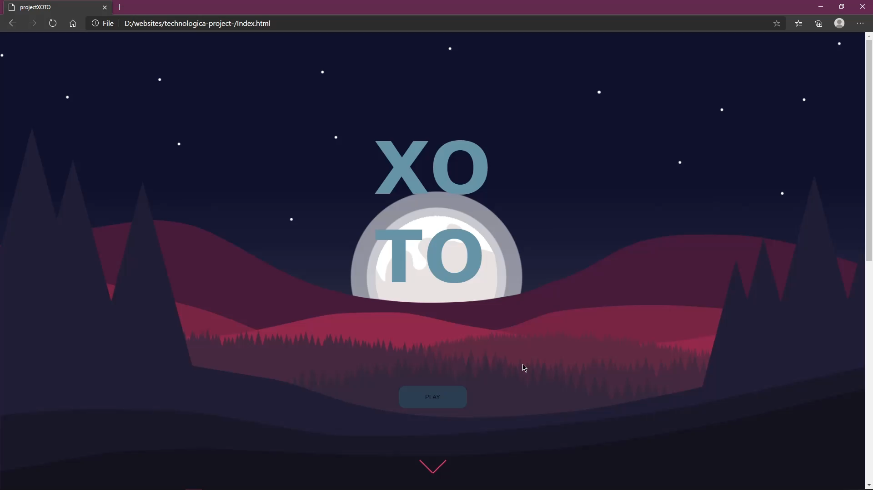
Showcase

Slide 7
Thank you for your attention

Slide 8
Q & A

